Slide 1
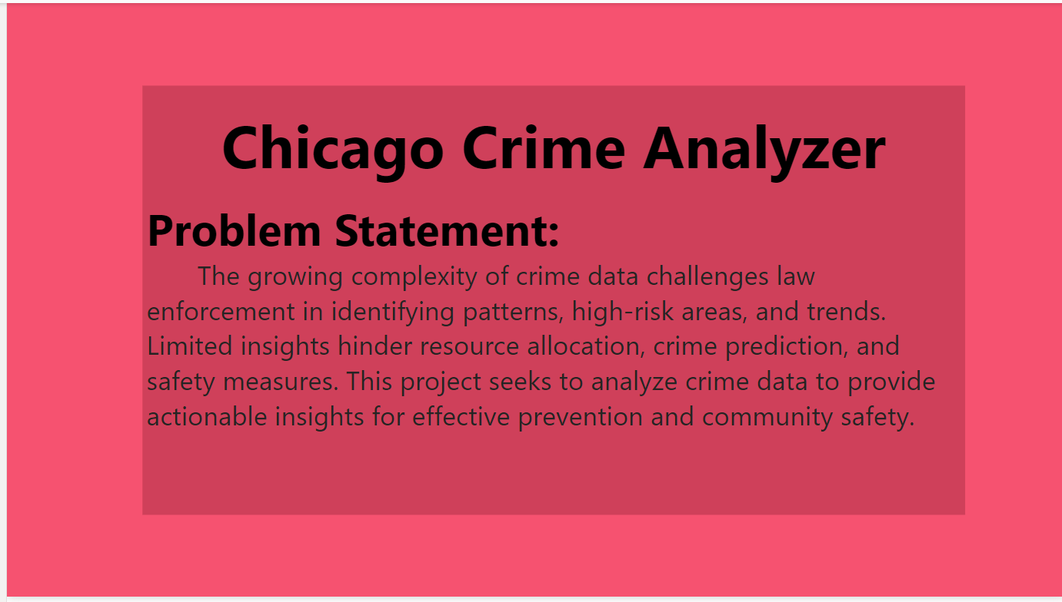

Slide 2
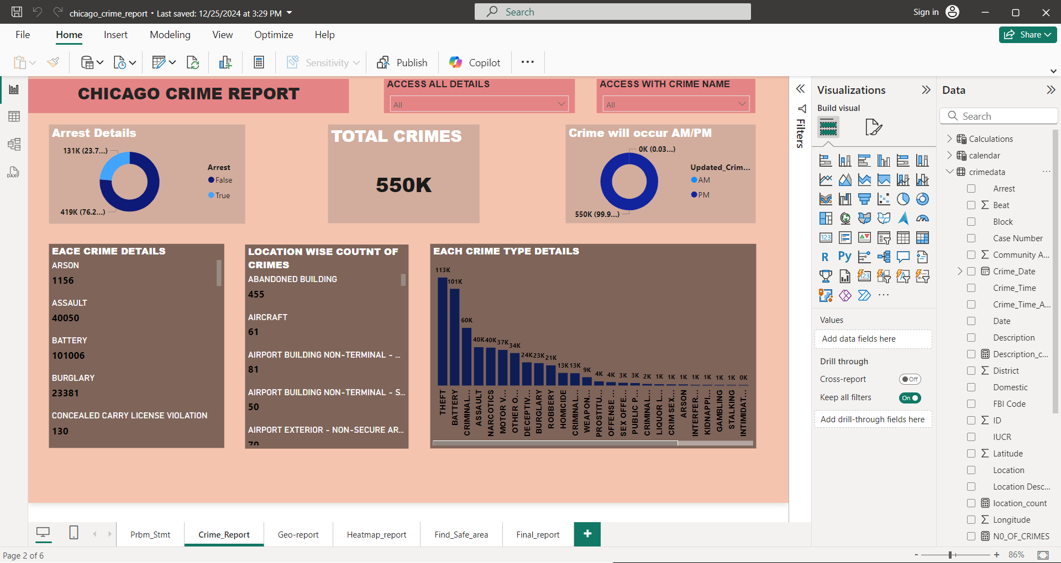
CHICAGO CRIME Report analysis:

Slide 3
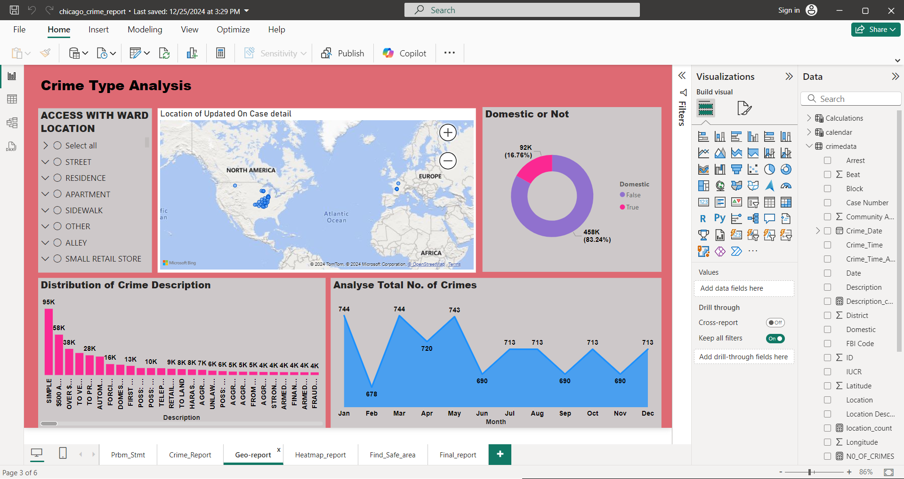
CHICAGO CRIME Report analysis:

Slide 4
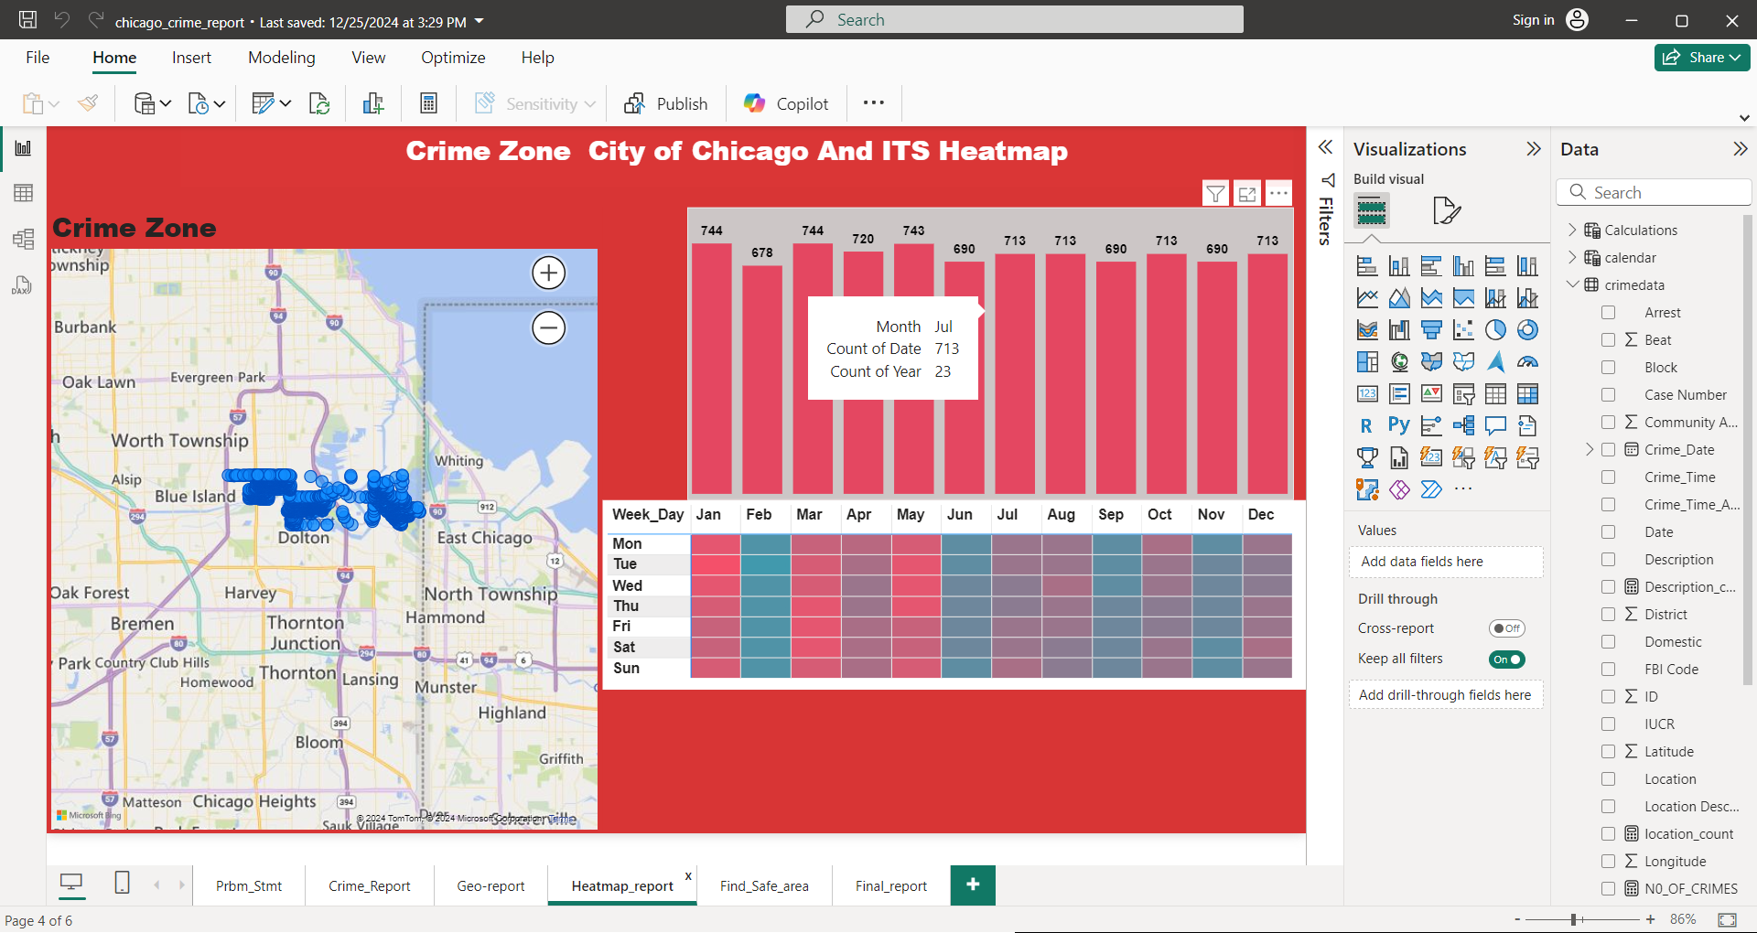
CHICAGO CRIME Report analysis:

Slide 5
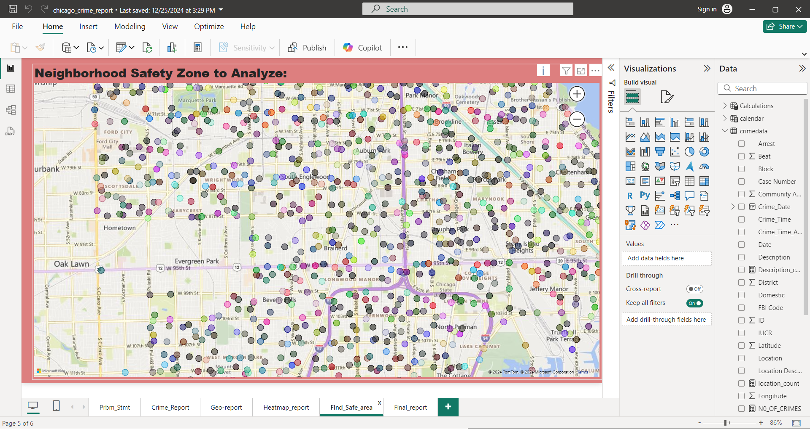
CHICAGO CRIME Report analysis:

Slide 6
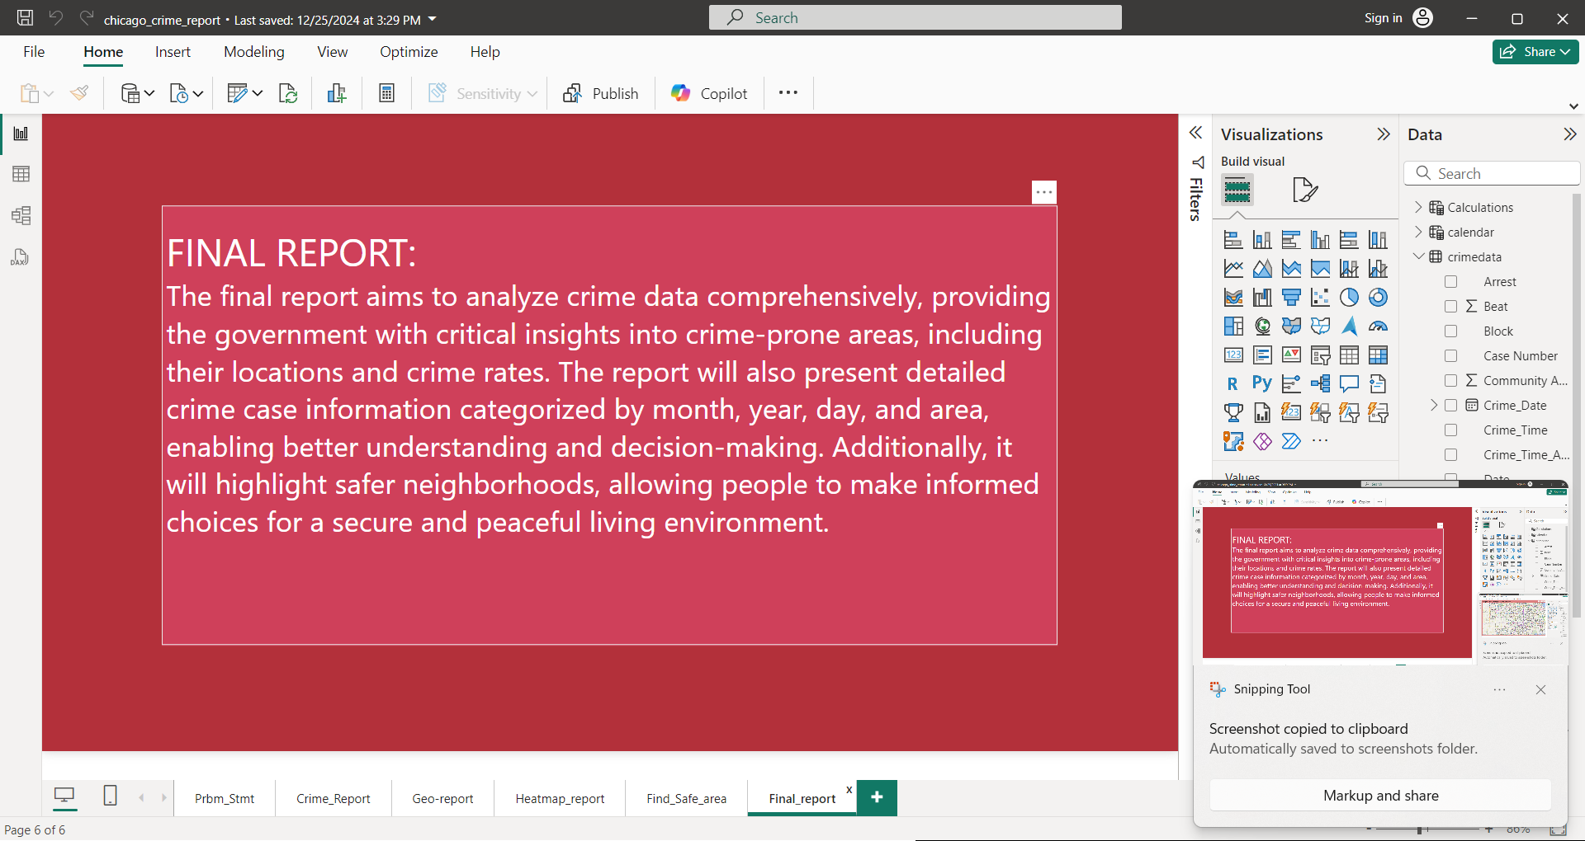
CHICAGO CRIME Report analysis:

Slide 7
THANK YOU

